Slide 1
Introduction to Machine Learning
Adwait

Slide 2
Agenda
What is machine Learning
What is data science
Tools required to get started

Slide 3
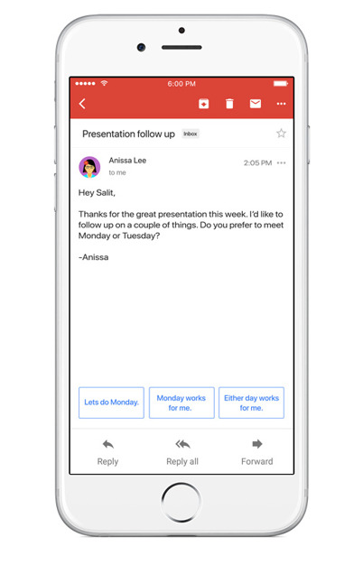
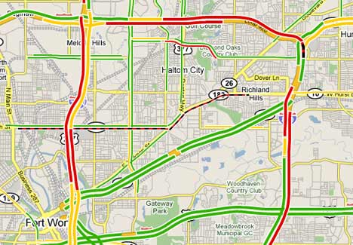
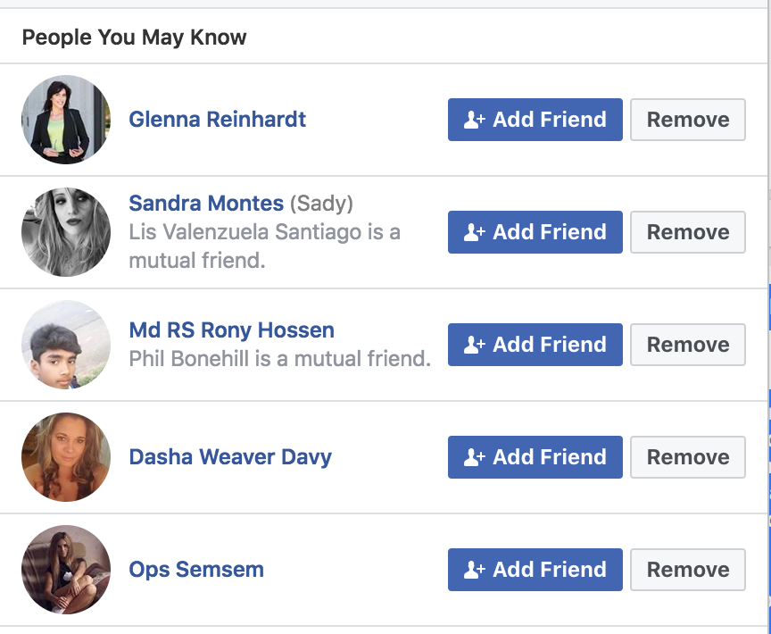
In your hand
Notes:
source images :
https://appleinsider.com/articles/17/05/17/google-adds-smart-replies-to-gmail-for-ios-based-on-machine-learning
https://communityrising.kasasa.com/bots-better-marketing/amazon-recommends/
https://images.techhive.com/images/article/2013/08/mylist-100050912-large.jpg

Slide 4
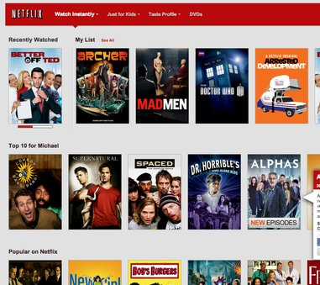

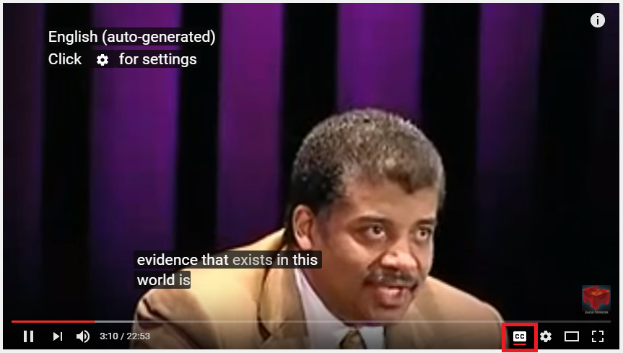
On your screen

Slide 5
Across industries
Fraud Detection
Pricing Products
Analyzing Review Sentiments
Cancer Treatment
Travel Planning
Insurance Premium
Oil Exploration
Predictive Maintenance
Intelligent Farming
Driverless cars

Slide 6
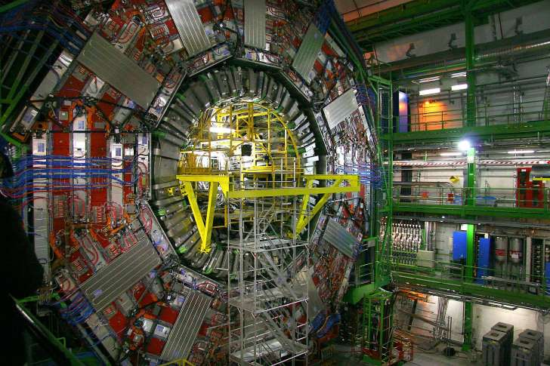
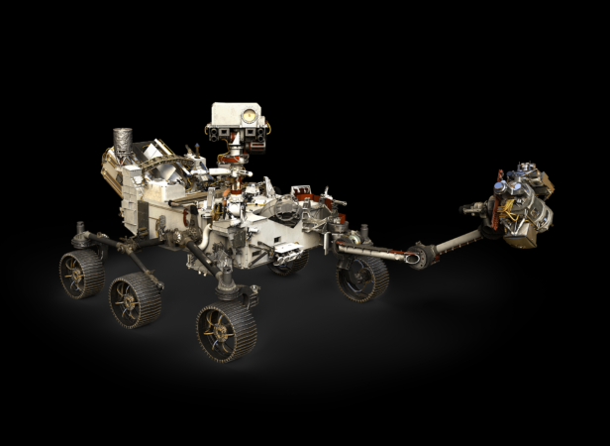
And...
Notes:
LARGE HADRON COLLIDER
http://mentalfloss.com/article/541154/giant-machines-changed-world

Slide 7
Why?
we want to create ‘intelligence’ artificially?
To understand human intelligence.
To perform tasks which may pose threat to human life.
When human resource is not available.
Augment human abilities.
Increase human efficiency.
Notes:
Ref : https://people.eecs.berkeley.edu/~russell/intro.html

Slide 8
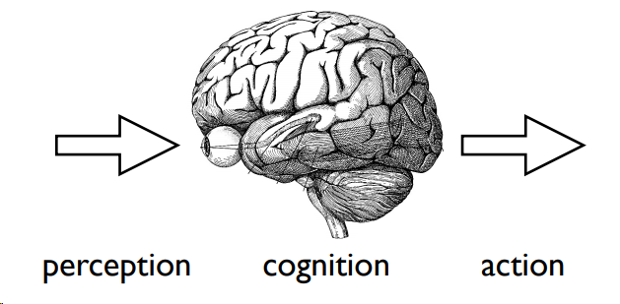
Model of intelligence
Notes:
Ref : https://www.cs.cmu.edu/afs/cs/academic/class/15381-s07/www/slides/011607comboIntro.pdf

Slide 9
Examples of Goals
Chess board -> find best move
Object -> recognize
Sound -> speech recognition
Text -> meaning
Map -> navigation
Notes:
Ref : https://www.cs.cmu.edu/afs/cs/academic/class/15381-s07/www/slides/011607comboIntro.pdf

Slide 10
Some issues
Can machine build useful representation from inputs?
Just knowing all the facts enough?
How to process information under uncertainty/ contamination?
What if the world is changing?
Model, Memory, Probability and weights, Learning

Slide 11
Programming by example
Examples
Algorithm
Model

Slide 12
Learning Problem 1 (Training Data)
Instance | Label
ant
bat
dolphin
leopard
sea lion
zebra
shark
mouse
chicken
Notes:
Ref: https://www.cs.princeton.edu/courses/archive/spr08/cos511/scribe_notes/0204.pdf

Slide 13
Learning Problem 1 (Test Data)
Instance | Label
tiger
flamingo
tuna
lizard
What did you learn?
What knowledge you used?
Notes:
Ref: https://www.cs.princeton.edu/courses/archive/spr08/cos511/scribe_notes/0204.pdf

Slide 14
For machine
Instance | Type | Habitat | Label
ant | insect | land
bat | mammal | land
dolphin | mammal | water
leopard | mammal | land
sea lion | mammal | water
zebra | mammal | land
shark | fish | water
mouse | mammal | land
chicken | bird | land

Slide 15

Explicit programming vs learning rules
If (type = mammal) and (habitat = land)
Then
Else
Machine approximately learns the same rule.

Slide 16
Learning Problem 2 (Training Data)
GPA (Instance) | GRE (Label)
3.70 | 637
3.18 | 562
2.90 | 520
2.93 | 624
3.02 | 500
3.05 | 500
3.77 | 700
3.12 | 560
2.5 | 500
Notes:
Ref: https://www.cs.princeton.edu/courses/archive/spr08/cos511/scribe_notes/0204.pdf

Slide 17
Learning Problem 2 (Test Data)
GPA (Instance) | GRE (Label)
3.25
3.48
3.80
2.74
How this problem is different?
Notes:
Ref: https://www.cs.princeton.edu/courses/archive/spr08/cos511/scribe_notes/0204.pdf

Slide 18
How to check?
If machine has learnt anything?
Need performance measure
Training vs Test
Can we see the model?

Slide 19
Mistakes machines can make after learning
Common mistake # 1: Memorization and performing poorly on test. Learning every instance value and not learning the general rule well.
This is called Overfitting! Also remember the word ‘Variance’
Common mistake # 2: Generally preferring one answer and thus minimizing overall error. But not learning general rule well.
This is called underfitting! Also remember the word ‘Bias’

Slide 20
How to make it better
Show more examples.
Change learning algorithm
Help with more descriptive features
Perform more validations

Slide 21
Summary
Various application of machine learning
Machine learning is a different way of programming machines.
It works for a specific task.
Need to provide many examples with labels.
Need to define performance measure.
Need to validate if learning has happened.

Slide 22
“All models are wrong but some are useful"”
George Box

Slide 23
Thanks!

